Slide 1
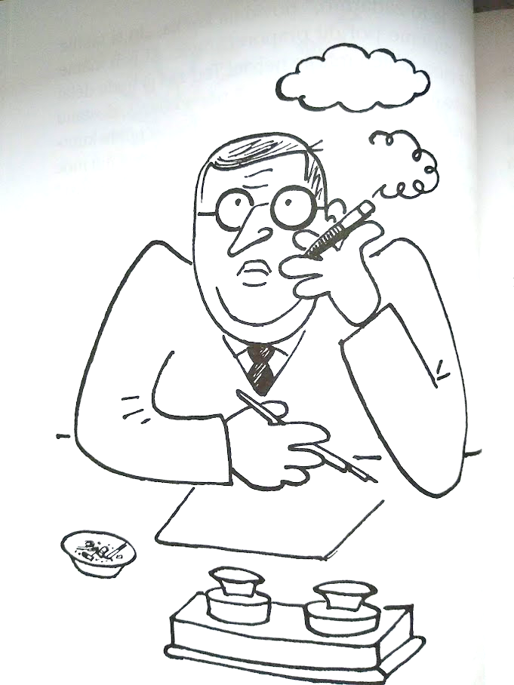
Dear kids!
as you definitely know…I am Mr. Josef Čapek and I am supposed to write a book „All about Doggie and Pussycat“ and I‘m currently out of ideas…
Please advise me what to write in there to make sure the kids like it.
Click me
You can continue here

Slide 2
I am Karel Čapek – a writer and a journalist
So, who wrote All about Doggie and Pussycat?
I wrote more. Do you know the word ROBOT – I came up with that…
Well, me.
But later on I enjoyed painting more.
I am Josef Čapek – a painter and a writer
Will you help us unlock the locks that will take us home?
You wouldn‘t get there on foot – it‘s in Prague…
continue….

Slide 3
Mr. Čapek doesn‘t know the meaning of some old words.
Who will advise him?
I don‘t know. I am not even sure if to sign „doggie“ or „doggy“…
The kids will have to advise…

Slide 4
What is actually put in the cake and what is not?
Please, advise…

Slide 5
And where is it?
I hope not far…
We are almost done washing the floor.
How about going to Nymburk or Domažlice?
Oh, that foam! I will never eat soap again. Even if it was pink…

Slide 6
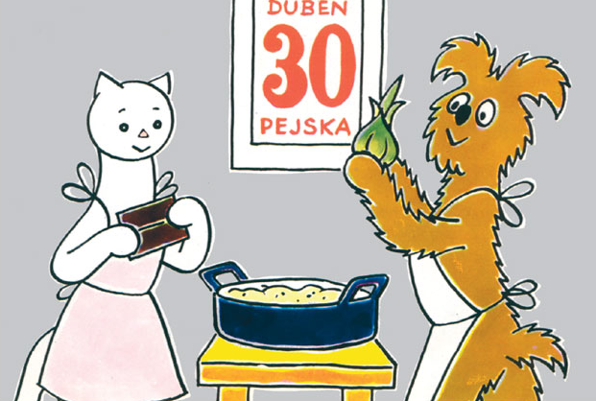
No, no … neither chocolate nor onion.
Do you remember all the letters? I keep my fingers crossed that you get to the reward…
And since you have come this far, you will get a reward – maybe a chocolate…?
So, let‘s have the reward…

